Slide 1
Dynamic Presentations
Bob Marshall, MD MPH MISM FAAFP
Program Director, DoD/MAMC Clinical Informatics Fellowship

Slide 2

Take home points
Repeat 3-5 main points
Entertain to gain their attention
Involve the audience
Visual aids help maintain interest

Slide 3
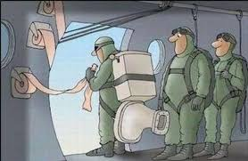
Look before you leap: PREPARE
Know your audience
Know the room and AV support
Test your talk

Slide 4
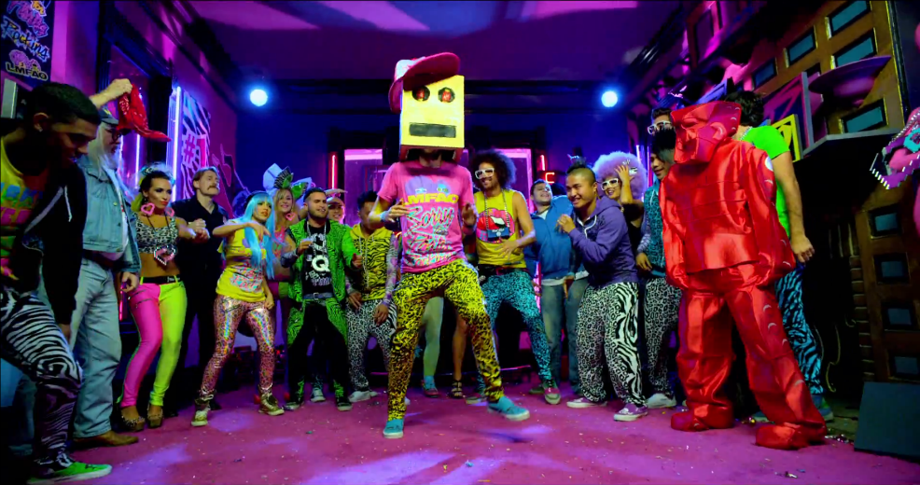
Introduction
Greet ‘em
Grab ‘em
Guide ‘em

Slide 5
Main Points
Confine your talk to 3-5 main points
Repeat these several times for retention
Last thing you say: take-home points

Slide 6
Entertain to gain their attention
“The world is a stage, but the play is badly cast.”
Oscar Wilde

Slide 7

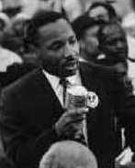
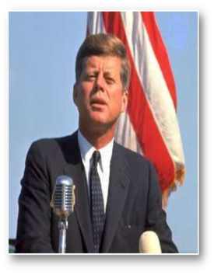
Entertain to gain their attention
Use body language
Vary inflection and pacing
Maintain eye contact, no slide watching!

Slide 8
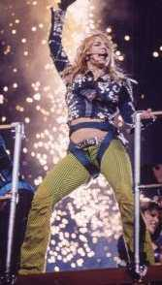
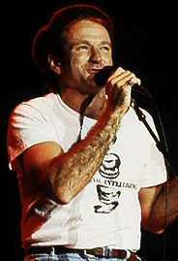
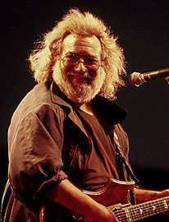
Entertain to gain their attention
Use anecdotes
Relevant
Short
Entertaining
Associate fact with memory
Show enthusiasm!
Be a motivational speaker!

Slide 9
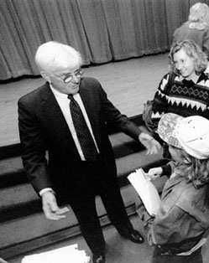
Involve your audience: Questions
Keep people awake
Force think/process vs. passively receive
Open mike vs. pimping
Work the crowd!

Slide 10
Involve your audience: Mix it up
Demonstration
Change in AV (i.e. short video)
Group brainstorming

Slide 11
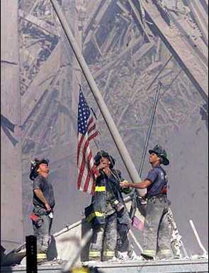
Visual Aids
A picture is worth
a thousand words

Slide 12

Visual aids: The 4 R’s
Readable
Reliable
Relevant
Repetitious

Slide 13
Readable
Font size is important!!!
Color choices- light words on dark background best
Shadowing helps text stand out, but should be tested for clarity

Slide 14
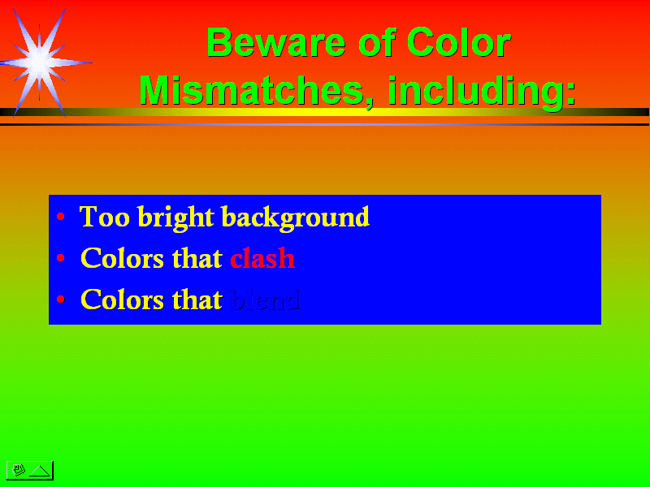

Slide 15
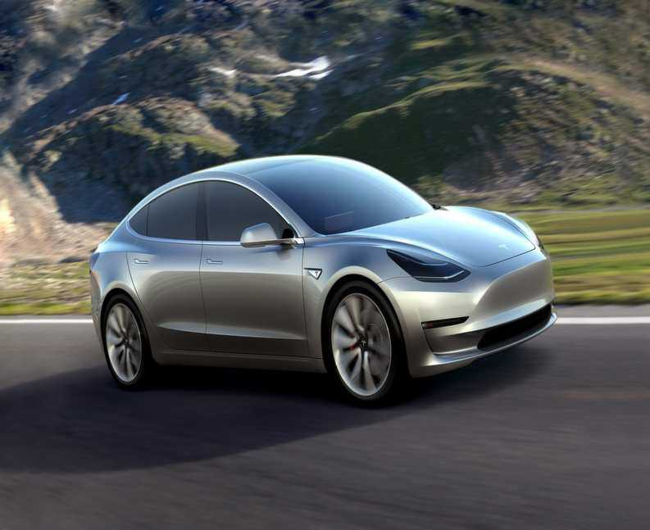
Readable
Animation in moderation (just a dab’ll do ya!)

Slide 16
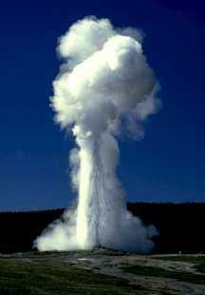

Reliable
Make sure you do a trial run
Have a back-up
VS.
Old Faithful
Baby needs a new pair of shoes!

Slide 17
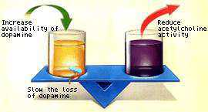

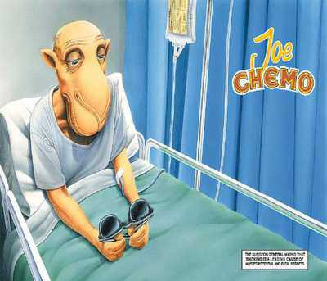
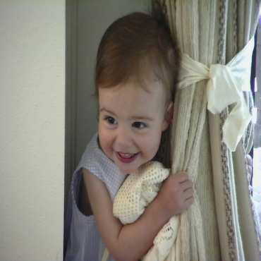
Relevant
VS.
Disclaimer: mental breaks can be ok….

Slide 18

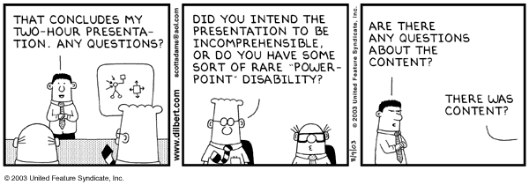

Slide 19
Repetitious
Thank you, sir, may I have another
Thank you, sir, may I have another
Thank you, sir, may I have another

Slide 20
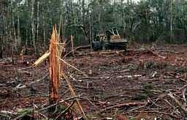
Handouts (“and the forests wept…”*)
Provide lasting reference of key points
Decrease note taking during talk
Don’t just print your slides!
More detail than slides, room for notes
*But Weyerhauser was quite happy.

Slide 21
Take home points
Repeat 3-5 main points
Entertain to gain their attention
Involve the audience
Visual aids help maintain interest

Slide 22
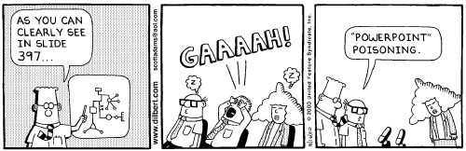
Questions?

